Slide 1
CS589: Project Details

Slide 2
Overview
The course project is an opportunity for you to apply what you have learned in class to a problem of your interest.
Your are encouraged to select a topic and work on your own project. Potential projects usually fall into these two tracks:
Applications. If you're coming to the class with a specific background and interests (e.g. biology, engineering, physics), we'd love to see you apply deep neural networks to problems related to your particular domain of interest. Pick a real-world problem and apply deep neural networks to solve it.
Models. You can build a new model (algorithm) with deep neural networks, or a new variant of existing models, and apply it to tackle vision tasks. This track might be more challenging, and sometimes leads to a piece of publishable work.

Slide 3
Timeline
Parts
Proposal: June 5, 2024
Milestone: June 20, 2024
Final write-up: July 3, 2024
Can’t use extension “late days” for these deadlines!!!

Slide 4
Projects as a mini-conference
You will write a paper with your team.
A suggested format will make sure you cover the right kinds of topics.
TA and I will grade all the final write-ups at the same time as the reviews. I will not use the review scores directly

Slide 5
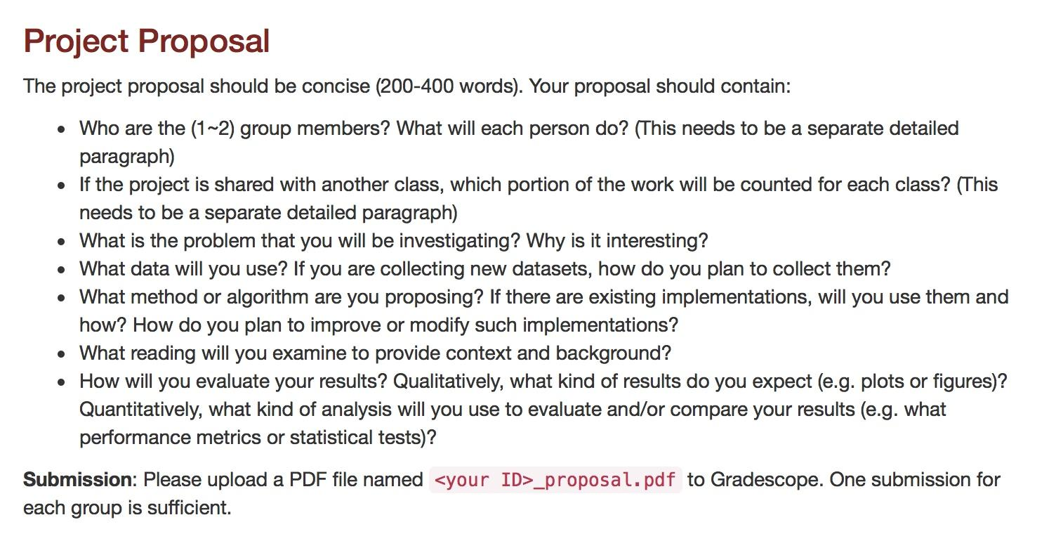

Slide 6


Slide 7
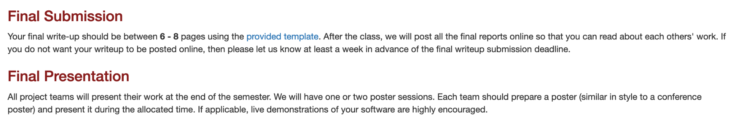

Slide 8
Project Ideas

Slide 9
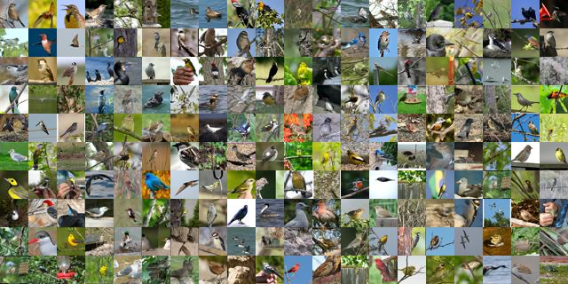
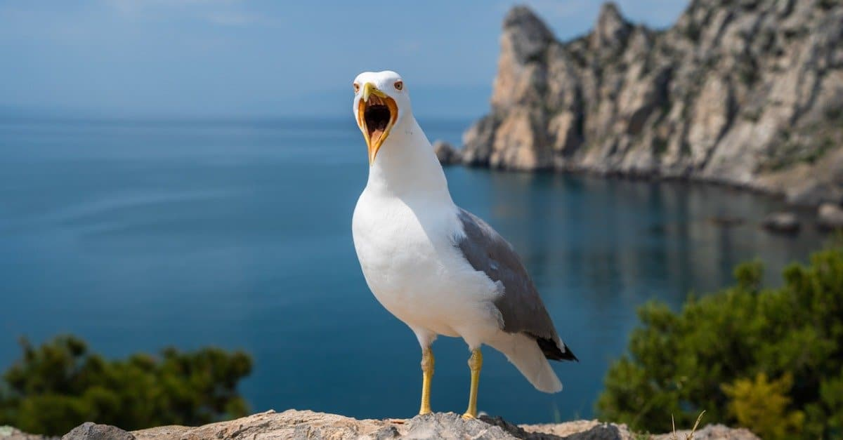
Friend or Foe? Analysis of training on out-of-distribution data on fixed test set
Motivation: Given a fixed training and test set (Example: CUB dataset), how can you select new training samples such that model performance on test set improves?
Relevant Areas: classification, Active learning, Self-Supervised Learning.
Good?
Bad?

Slide 10

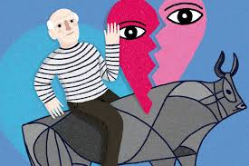
Is charizard a dragon? zero-shot categorization/attribute discovery of art work
Motivation: Given an artwork, can we understand what's in the artwork without training any model on the artwork itself? Does the discovered attribute align with human perception?
Relevant Areas: Vision-Language models, Attribute discovery, Human evaluation.
Dragon
Lizard
Orange
Fire
Old man
Heart
Bull
Eyes

Slide 11
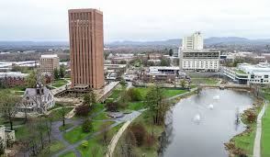
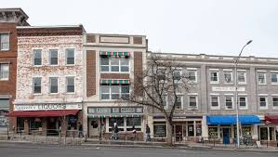
What makes Amherst look like Amherst?
Motivation: Given multiple images of different places of Amherst, can we find what are the characteristic visual elements that make Amherst unique?
Relevant Areas: Clustering, Coreset selection.
Reference: http://graphics.cs.cmu.edu/projects/whatMakesParis/paris_sigg_reduced.pdf

Slide 12
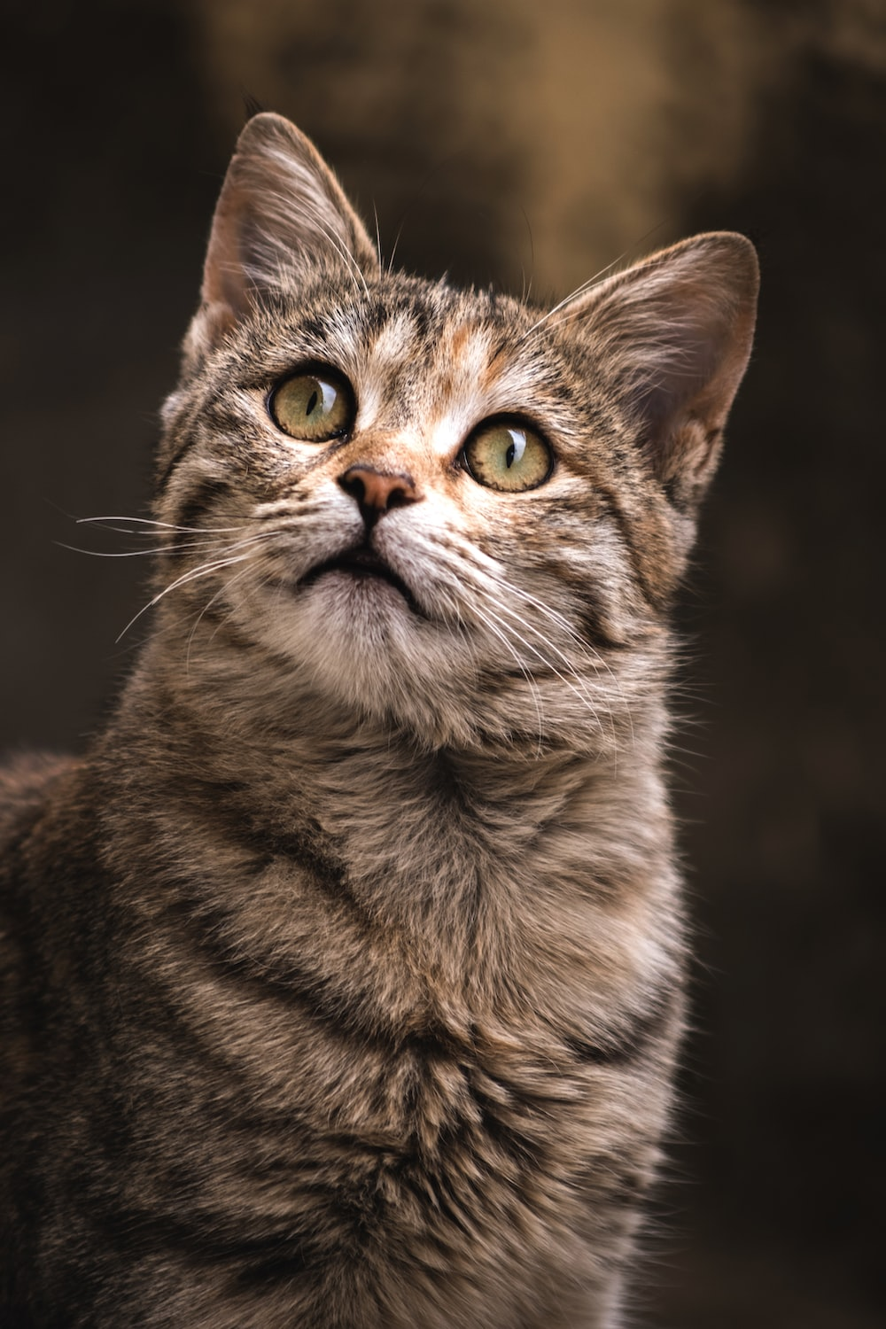
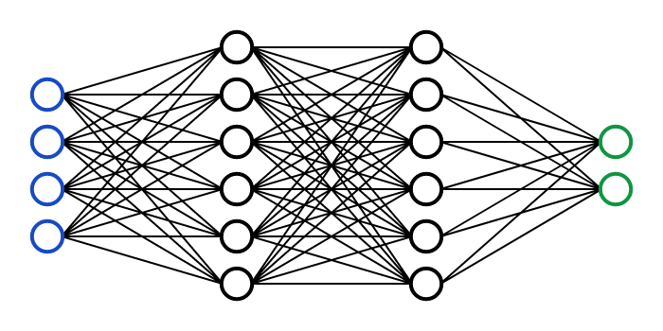
Representation learning
Train a model that takes an image and produces a representation vector that is useful for downstream tasks.
Use self-supervised learning to learn useful representations of data.
How useful are your representations for classification?
Can you do well with other downstream tasks?
( ,cat)
( ,cat)
https://openreview.net/forum?id=xm6YD62D1Ub

Slide 13
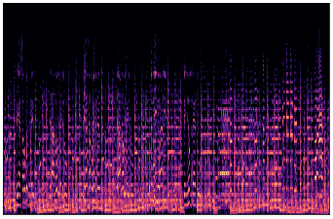
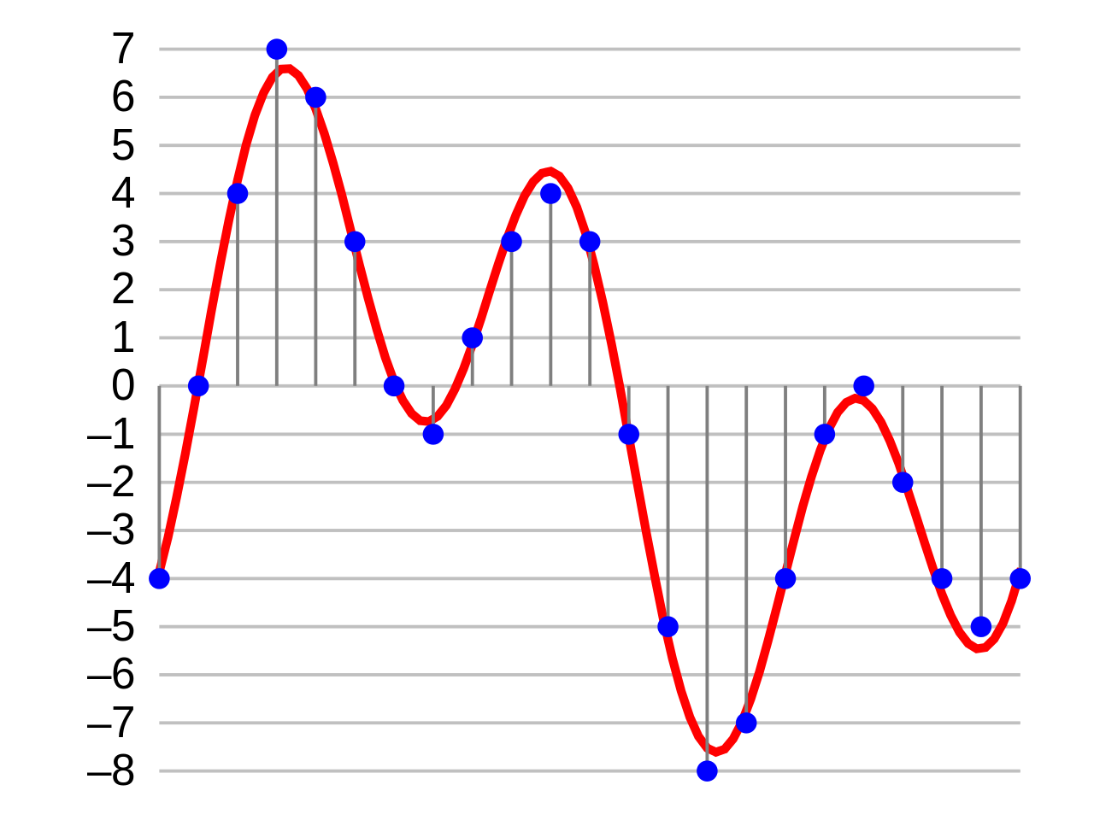
Audio classification with CNNs
What's the best way to classify music genre?
A very common approach to machine learning with sound converts the audio sample into a spectrogram image which is then passed to a CNN.
Can you come up with a better approach? Are there modifications to the kernel size, conv layer, activation function, etc. that would be better for a spectrogram image compared to a natural image? Or maybe you can think of an alternative architecture to CNNs that could be used with the raw waveform?
The GTZAN dataset provides song samples and spectrogram images with corresponding genre labels. You can use this data to classify which music genre a corresponding audio sample represents. Alternatively, find your own audio dataset!
Label: “Blues”

Slide 14
Mini-Spotify: neural network based music retrieval
Motivation: Can you build a simple recommender system for suggesting similar songs given a query song? What information would you require to find similar songs?
Relevant Areas: Metric learning, Information retrieval.
Datasets: https://gist.github.com/alexanderlerch/e3516bffc08ea77b429c419051ab793a

Slide 15
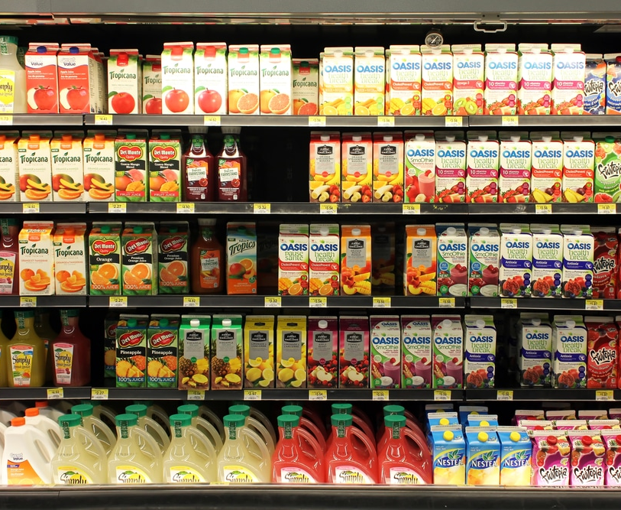
Object localization based on textual description
Image Input
Chat question answering
Q. Is there soda here?
Model Ans. No
Q. Where is the orange juice?
Model Ans.
Applying Visual Grounding in Real-world Scenarios
Visual grounding is the process of linking textual descriptions to specific regions in an image.
For example, find if a certain item is present in a picture of a grocery store aisle.

Slide 16
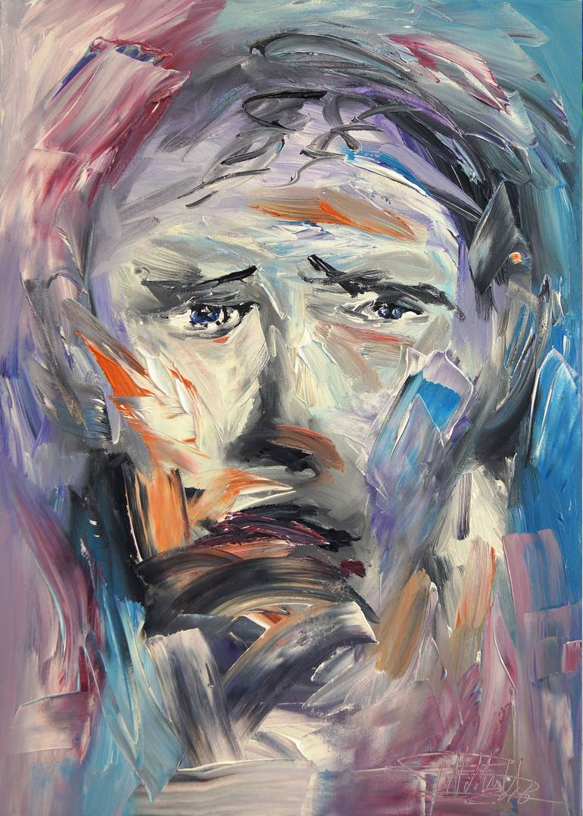
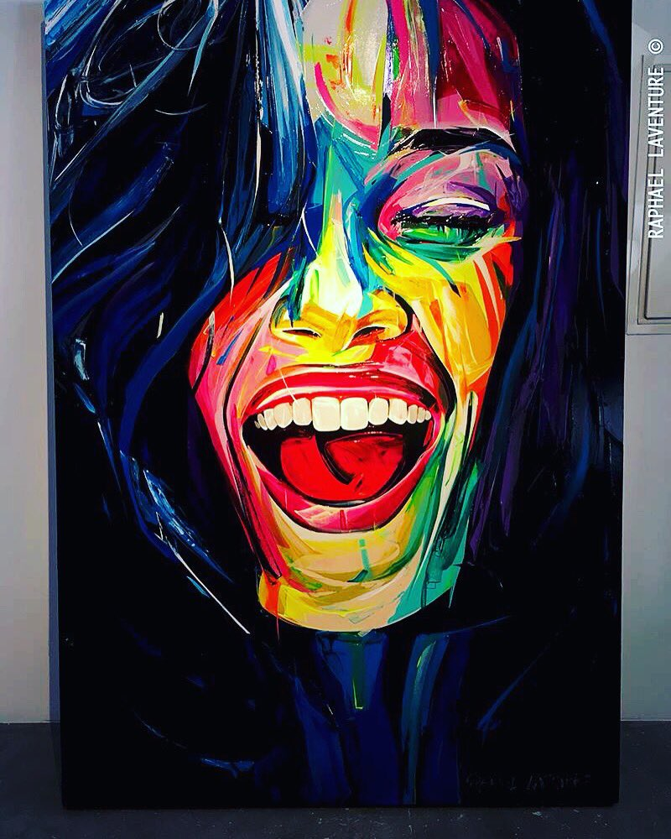
Emotion-based Style Transfer
Adjust the artistic style transfer based on detected emotions in the content image.
Use a melancholic painting style for sad expressions and lively, vibrant styles for joyful ones.
In the examples to the right, the sad face painting uses dull colours whereas the happy one uses bright colors.

Slide 17
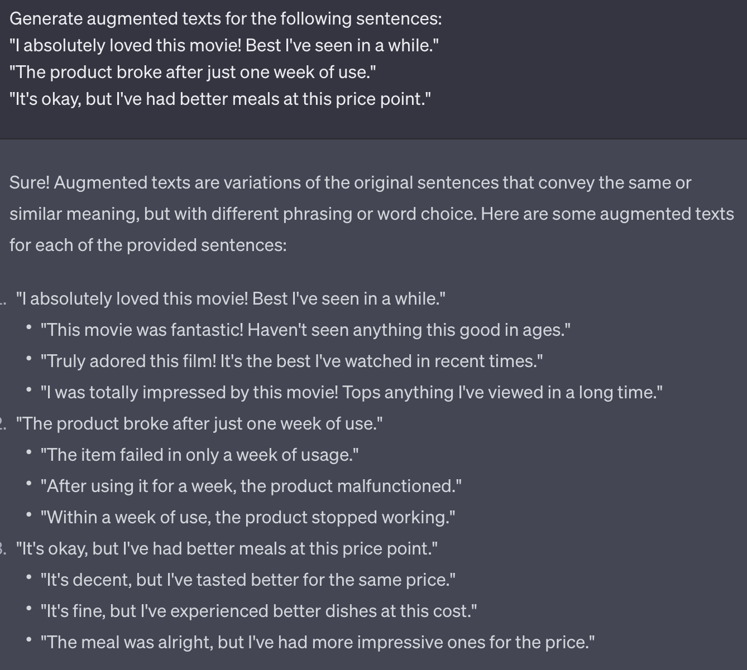
Text Augmentation using LLMs
Leverage LLMs to boost performance in text classification by generating augmented text.
Primarily target under-represented categories to create a balanced dataset.

Slide 18
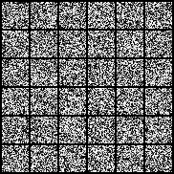
Mini diffusion model for MNIST
Build a baseline diffusion model for MNIST. Then try to reduce the model’s size to save computation while maintaining reasonable performance.
Various lightweight model design techniques can be considered including depthwise conv, quantization and pruning.
TA: Junyan

Slide 19
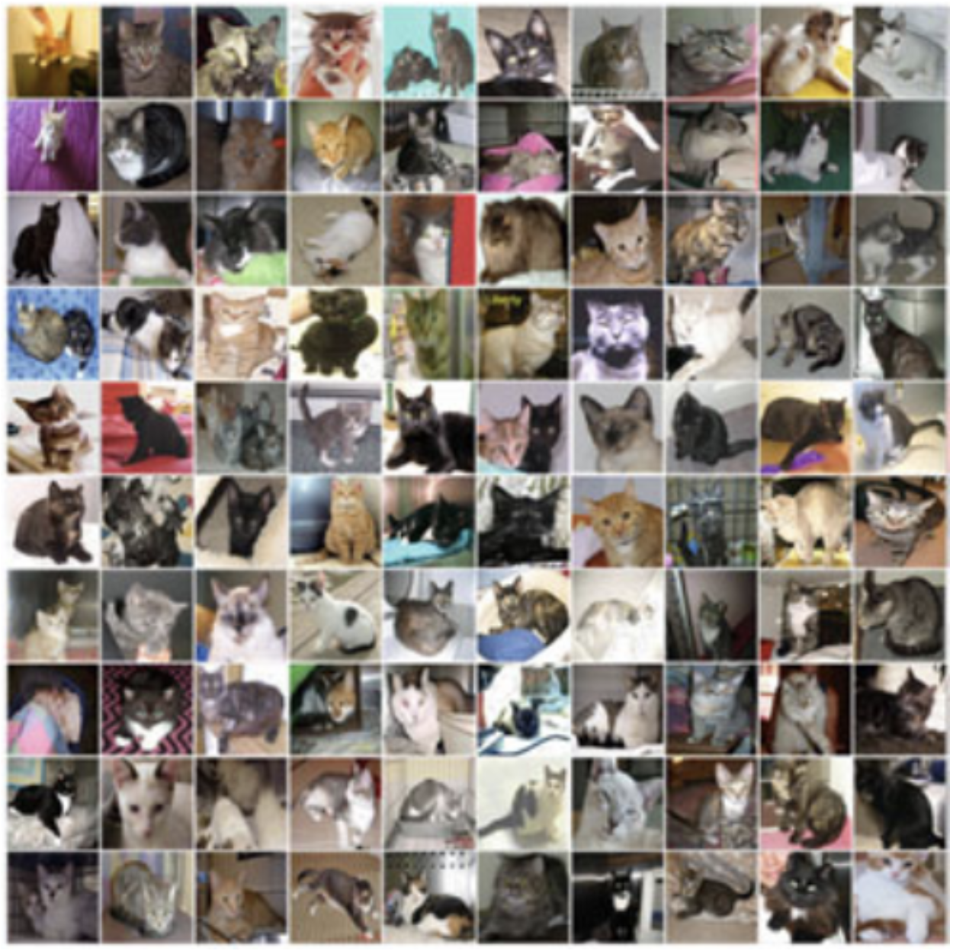
The evolution of zero-shot Cats vs Dogs Classification
Design and evaluate three types of zero-shot cats-vs-dogs classification models: kNN, CNN, and CLIP (multimodal LLM such as BLIP-2 is a bonus)
Zero-shot means that the model is not trained using cats-vs-dogs data. For CNN classification models, since most of them are trained on ImageNet and ImageNet contains dogs and cats, you are not allowed to use the pre-trained classification head. Instead, use the feature from the pre-trained backbone to do zero-shot classification.
Reference:
https://www.kaggle.com/competitions/dogs-vs-cats/data

